Slide 1
Predicting Property Value
Group 5:
Michael Didonato Vysnavi Mathavaraj Weiyuan Fan Yue He

Slide 2


Project analysis slide 2
Problem & Motivation
Problem
What variables are good predictor for property value in America？
Motivation
All group members are interested in house price.
Interested in what and how variables effect the property value in America?
Predict the property value, and solve problems:
For example: when we are trying to purchase a house with 3 bedrooms, how much we should pay?
If our annual income is $70,000, how much we should prepare so that we could afford the houses price？

Slide 3

Project analysis slide 11
Data Sources
This data set is American Community Survey 2014-2018 ACS 5-Year PUMS Files, which is a subset of the American Community Survey (ACS) Public Use Microdata Samples (PUMS) from US Census website.
Our intended population is homeowners of the United States from 2014 to 2018. The sample size is 18046 homes. After data cleaning and randomized, we have 5277 effective data for our multiple linear regression model.
(https://www.census.gov/programs-surveys/acs/about.html)
(https://www.census.gov/programs-surveys/acs/technical-documentation/pums/documentation.html)

Slide 4

Project analysis slide 11
Variable Selection
Our data contains 237 factors (Columns), but most variables are unrelated to our problems.
Some variables have strong correlations with other variables.
Run over 20 models, decide our final model by 3 methods.
Dependent Variable
VALP | Property value
Independent Variable
BDSP | Number of bedrooms
BATH (Dummy variable) | Bathrooms 1= the house has Bathtub or Shower); 2 = the house doesn’t have Bathtub or shower (reference group)
RMSP | Number of rooms
FINCP | Family Income
NPF | Number of people in a Family
ACR (Dummy variable) | Lot Size 1=house on less than one acre (reference group); 2=house on one to less than ten acre; 3=house on ten or more acres
NOC | Number of Own Child
CONP | Condo fee (monthly amount)
ELEP | Electricity cost (monthly cost)
FULP | Fuel cost (yearly cost for fuels other than gas and electricity)
INSP | Fire/hazard/flood insurance (yearly amount)
HINCP | Household income past 12 months
OIP | All other income past 12 months
WATP | Water Cost (yearly cost)

Slide 5
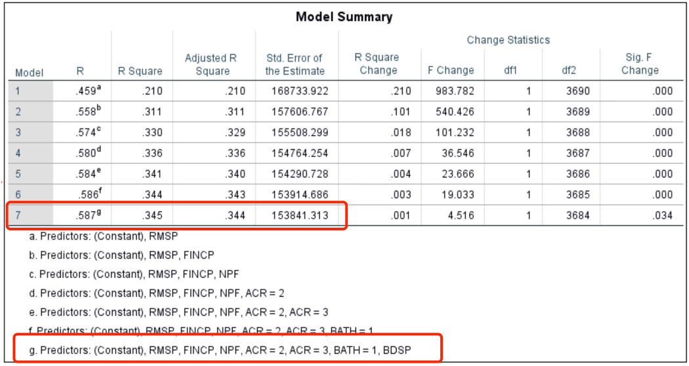
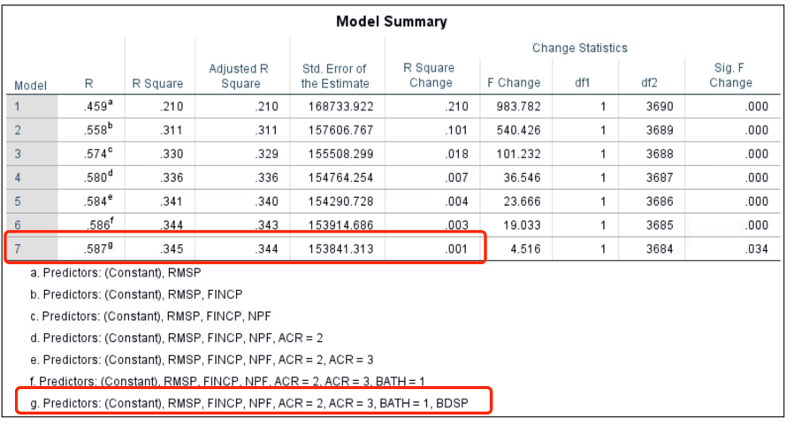
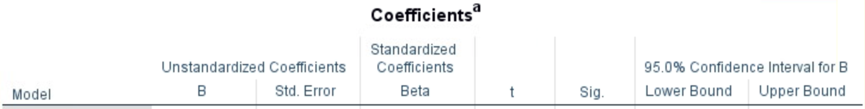
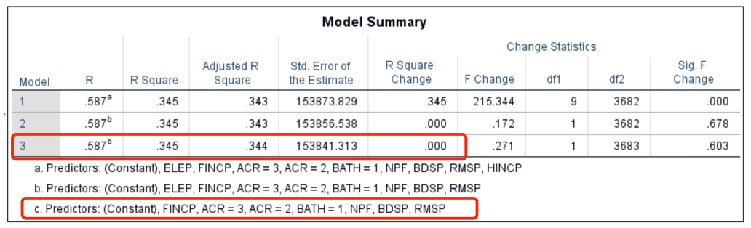
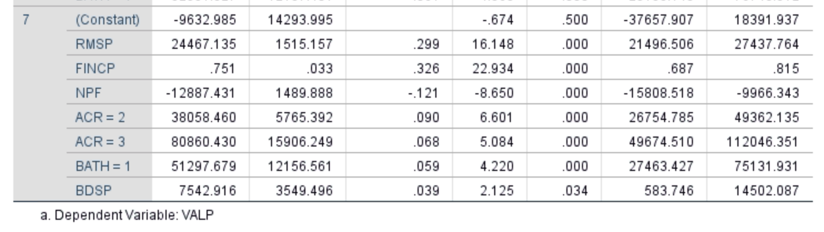
Project analysis slide 11
Predictive Model
Forward
Stepwise
Backward

Slide 6
Project analysis slide 11
Hypothesis testing
Multiple coefficient of determination (R² = 0.345), implies that 34.5% of the variation in the dependent variable, VALP is explained by the independent variables that are included in this model.
For joint test, H₀: β₁ = β₂ = … = β_{k} = 0 H_{a}: At least one β_{j} ≠ 0
Rejection rule : If p-value < Alpha, Reject H₀.
Result: 0.00 < (0.05), Reject H_{0.} Model is significant.
For individual test, H₀: β_{j} = 0 H_{a}: β_{j} ≠ 0
Rejection rule : If p-value < Alpha, Reject H₀.
Result: p-value of all the IV’s < alpha (0.05), Reject H₀.
All the IV’s are significantly related to the dependent variable, VALP.

Slide 7
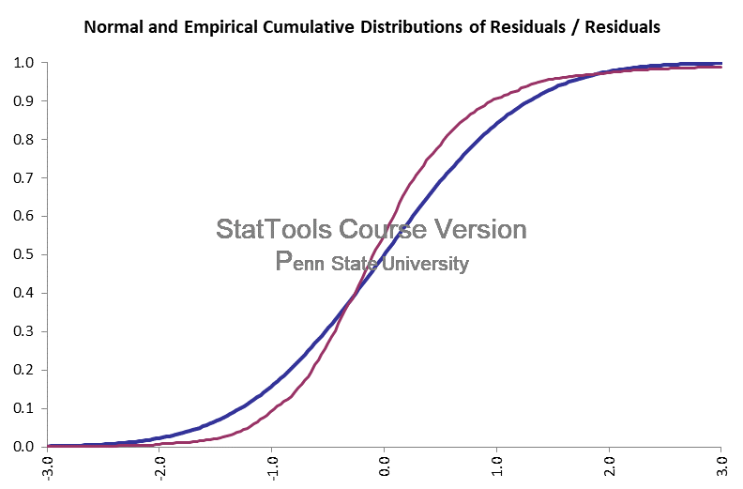
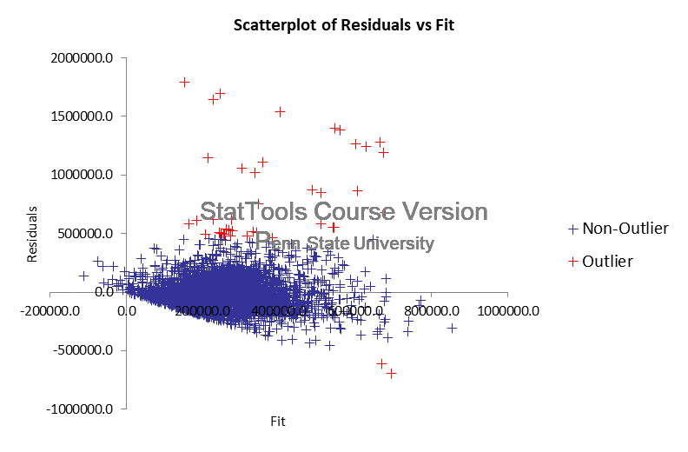
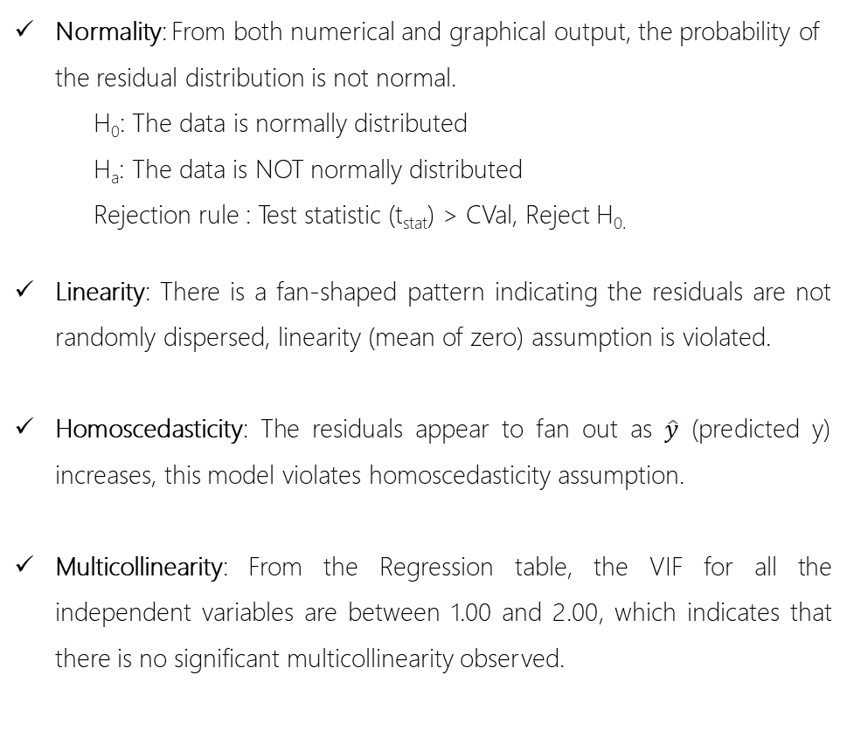
Project analysis slide 11
Tests
Normality: From both numerical and graphical output, the probability of the residual distribution is not normal.
H₀: The data is normally distributed
H_{a}: The data is NOT normally distributed
Rejection rule : Test statistic (t_{stat}) > CVal, Reject H_{0.}
Linearity: There is a fan-shaped pattern indicating the residuals are not randomly dispersed, linearity (mean of zero) assumption is violated.
Homoscedasticity: The residuals appear to fan out as $\hat{y}$ (predicted y) increases, this model violates homoscedasticity assumption.
Multicollinearity: From the Regression table, the VIF for all the independent variables are between 1.00 and 2.00, which indicates that there is no significant multicollinearity observed.

Slide 8
Project analysis slide 7
Residual Analysis
 | R-Square | Adj. R-Square | Std. Error | SSE | RMSE
Validation Set | 0.2965 | 0.2934 | 172700.36 | 4.70347E+13 | 172263.98
Training Set | 0.3448 | 0.3435 | 153841.31 | 3.73231E+13 | 153452.58
In validation set, 29.65% of the variation in the dependent variable VALP is explained by the independent variables which are ACR=2, ACR=3, BATH=1, BDSP, RMSP, FINCP and NPF.
Analysis
The standard errors and SSE become bigger. This shows that the residual of the validation set is greater than that of the training set. It shows that the model fitting is not very good, and the data prediction is not very successful. RMSE is still large, indicating that the results are unstable.

Slide 9
Project analysis slide 11
Conclusions & Lessons Learned
Conclusions
Lessons Learned
Bedrooms and total rooms had minor collinearity according to the correlation matrix but far below VIF threshold
Number of people in a family decreased the overall property value (NPF coefficient = -$12,887 per person)
The amount of land had the largest contributing factor to Property Value (ACR = 3 More than 10 acres of land) coefficient of $80,860
Data model variable selection can take a long time when dealing with large databases
Large standard deviation was exhibited ($153,695) and can be explained by the outliers in the residuals.

Slide 10

Project analysis slide 11
Future Directions
Future Directions
Data collection of alternate variables that subject matter experts believe to have effect on property value. This will increase our R² from 35%. Such variables could be:
Crime Rate in the area
Credit score of homeowners
Age of the home
Rural, suburban, urban categorical variables
Using prior years PUMS property value data (2014, 2015, 2016, 2017 and 2018) we could set-up a forecasted analysis to predict average future property value using Holt's trend methodology
Set-up a logistical regression to guess if a homeowner has a mortgage or owns the property outright. Based on low interest rates currently, the firm can target mortgage holders to try and get them to refinance.
Make property value a dependent variable
Add independent variable TEN for analysis

Slide 11
Questions?

